Slide 1
Background Services
In .NET
Doing the Real Work™ that no one sees.

Slide 2

Who is this guy?
Notes:
Just a guy.
Written hundreds of background services in .NET.

Slide 3
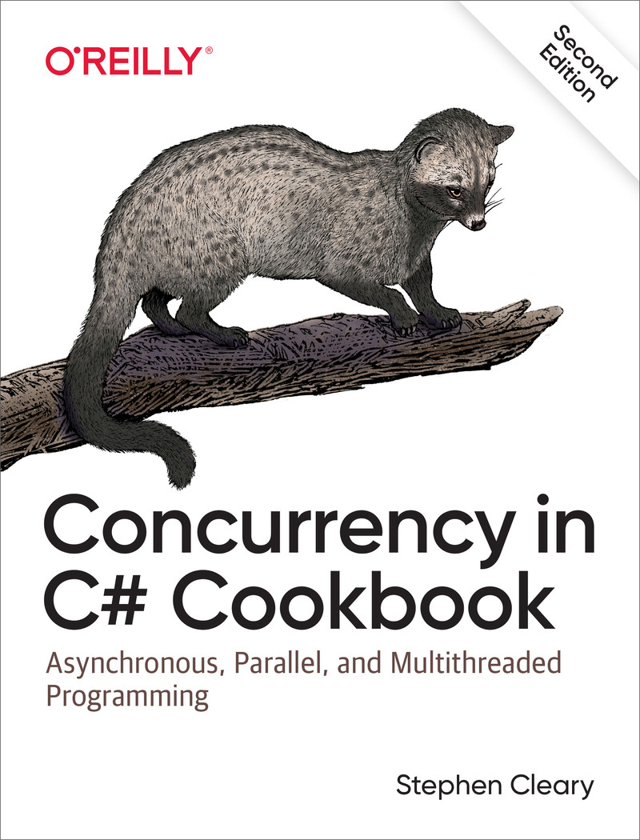

Slide 4
“Background Service”?

Slide 5
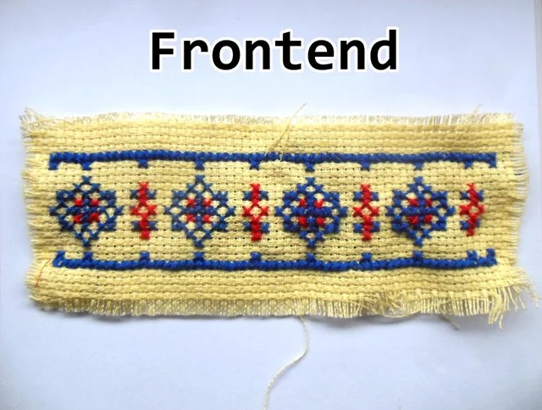
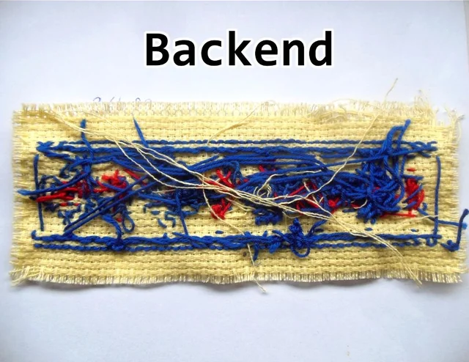
“Background Service” (for this talk)
Some piece of code that runs on the backend
The backend of the backend.
Common examples: queue processor, scheduled job
Tend to run in Docker containers, on VMs, or on on-prem hardware.

Slide 6
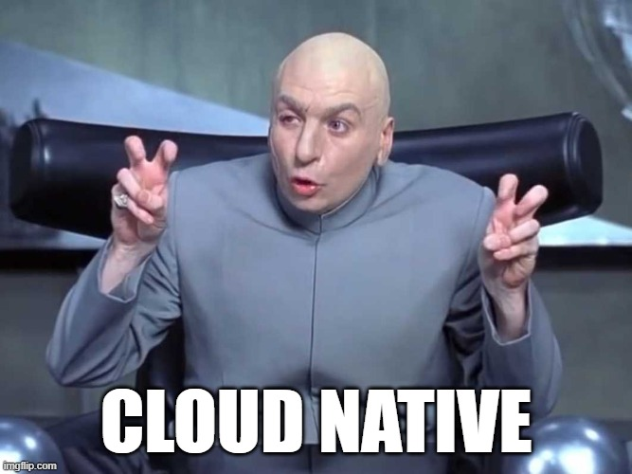
“Background Service” (for this talk)
Non-examples: could-native queue processors
Azure Function / AWS Lambda / Google Cloud Function
These provide their own hosting system.
Non-examples: Mobile/StoreApp "background jobs“
iOS Background Tasks / Android Task Scheduling / UWP Background Tasks
Again, a different custom hosting situation.
Notes:
If you want to leave now, I wouldn’t blame you!
I mention hosting a couple times in this slide, so let’s talk about hosting!

Slide 7

Hosting! And hosting…
Process host
Console (incl Docker), Win32 service, systemd, ASP.NET, UI
.NET (Generic) Host
BackgroundService, IHostedService

Slide 8
Process Hosts

Slide 9

Process Hosts: Docker
Use Linux Docker containers.
It’s a Console app! Done.
If you use Windows Docker containers:
Why do you hate yourself?
Pre-6.0 containers don’t support clean shutdowns out of the box: https://tinyurl.com/docker-windows

Slide 10
Process Hosts: Win32 Services
Reliability flag: https://tinyurl.com/win32svc-restart
Working directory is not where your exe/dll is. https://tinyurl.com/win32svc-basics
No redirected network drives; use UNC paths instead. https://tinyurl.com/win32svc-network

Slide 11
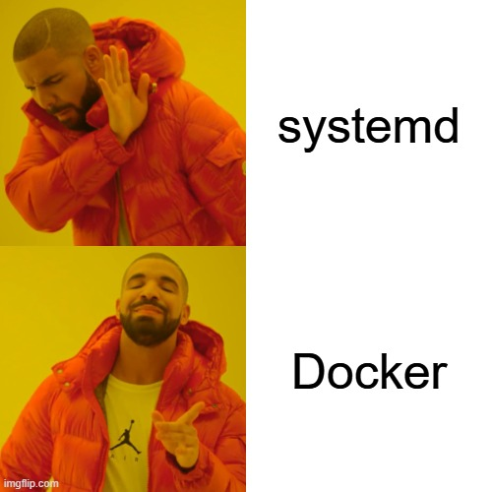
Process Hosts: systemd daemons
Don't use default working directory! https://github.com/dotnet/runtime/issues/113855
Actually causes a stack overflow exception. Fun!

Slide 12
Process Hosts: ASP.NET and UI
ASP.NET hosts are well-documented and thus not considered important enough to be covered much in this talk. There’s a fun example of terrible code coming later, though! https://learn.microsoft.com/en-us/aspnet/core/fundamentals/host/hosted-services
UI hosts are trickier. https://github.com/StephenCleary/Hosting currently supports WPF (WinForms is possible).

Slide 13
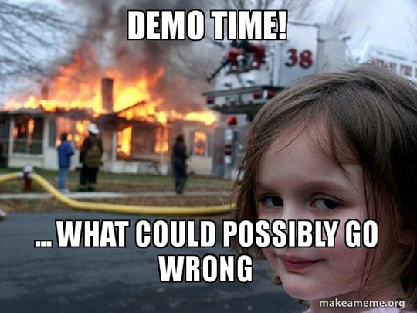
Notes:
Basic app running as Win32 service, systemd service, Console in docker.
(Taking shortcuts for the demo; normally you'd dotnet-publish and then copy those files in, set the entrypoint, and build the image)

Slide 14
Notes:
Adding background worker to existing ASP.NET app.

Slide 15
.NET Host

Slide 16
.NET Host: Host Lifetime
Working around a poor design:
https://tinyurl.com/backgroundservice-lifetime
Super details!
https://tinyurl.com/ihostlifetime

Slide 17
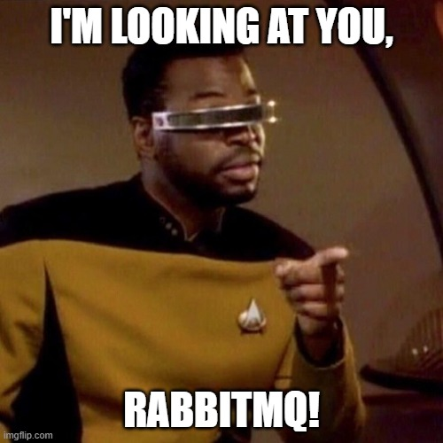
.NET Host: Host Startup
Synchronous starts: https://tinyurl.com/backgroundservice-startup
Most common: synchronously reading from a queue as the first real work in a worker.

Slide 18
.NET Host: Silent Failures
(pre-6.0 only): https://tinyurl.com/backgroundservice-failure

Slide 19
Notes:
FixedBackgroundServiceEx2

Slide 20
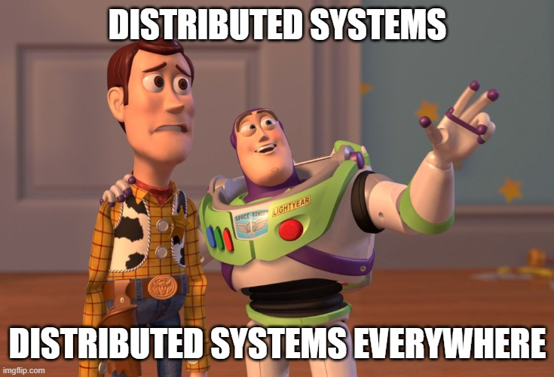
Distributed Background Services

Slide 21
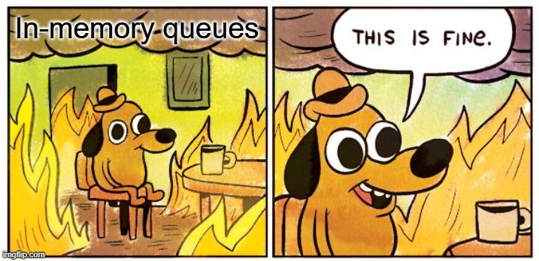
Allow Shutdowns
This sounds stupid, but it’s super easy to get wrong!
Including rolling upgrades!
Key point: no in-memory queues!
https://tinyurl.com/durable-queues
Yes, this popular MS example code is completely unsuitable for production! https://learn.microsoft.com/en-us/dotnet/core/extensions/queue-service

Slide 22
Allow Multiple Instances
Generally not a problem for queue consumers (since messages can be delivered out-of-order anyway… you knew that, right?)
For scheduled jobs that really should only be run by one instance, use a distributed lease.
Fairly easy to build on CosmosDB / DynamoDB / Redis.
https://tinyurl.com/distributed-lease

Slide 23
Common Patterns

Slide 24
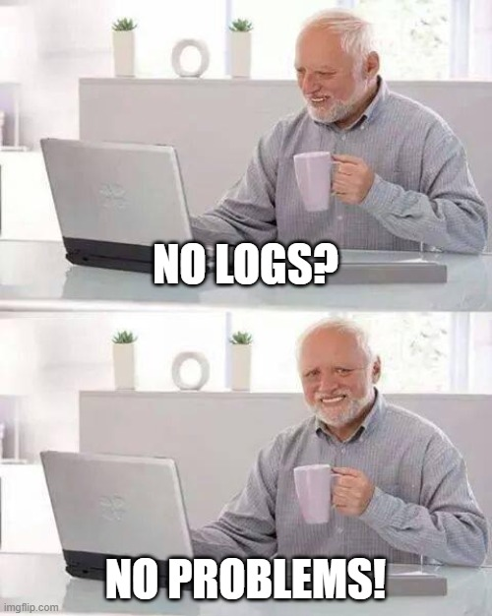
Common Patterns
CriticalServiceBase (already demo’d)
Logging:
Logging format may change per host. Consider JSON one-line-per-message for Docker.
Logging scopes!
Logging exception scopes! https://github.com/StephenCleary/Logging
Dependency Injection
Provide your own scopes: https://learn.microsoft.com/en-us/dotnet/core/extensions/scoped-service

Slide 25
Notes:
Queue consumer example (with local queue)
Scheduled job example (with leases)

Slide 26
Q&A

